Slide 1
Node.js
3/30/2024

Slide 2
Installing and Exploring Node.js

Slide 3
Getting started with Node.js
Introduction to Node.js
Node.js is an open-source server side runtime environment
Built on Chrome's V8 JavaScript engine.
Developed by Ryan Dahl in 2009.
It provides an event driven, non-blocking (asynchronous) I/O and cross-platform runtime environment for building highly scalable server-side applications using JavaScript.
It provides a rich library of various JavaScript modules which simplifies the development of web applications using Node.js to a great extent.
Node.js = Runtime Environment + JavaScript Library

Slide 4
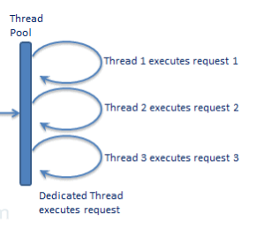
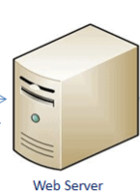
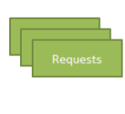


Node.js Execution Model
Introduction to Node.js
Traditional Web Server Model
In the traditional web server model,
Each request is handled by a dedicated thread from the thread pool.
If no thread is available in the thread pool at any point of time then the request waits till the next available thread.
Dedicated thread executes a particular request and does not return to thread pool until it completes the execution and returns a response.

Slide 5
Node.js Execution Model
Introduction to Node.js
Node.js processes user requests differently when compared to a traditional web server model.
Node.js runs in a single process and the application code runs in a single thread
So it needs less resources than other platforms.
All the user requests to web application will be handled by a single thread and all the I/O work or long running job is performed asynchronously for a particular request.
So, this single thread doesn't have to wait for the request to complete and is free to handle the next request.
When asynchronous I/O work completes then it processes the request further and sends the response.
An event loop is constantly watching for the events to be raised for an asynchronous job and executing callback function when the job completes.

Slide 6
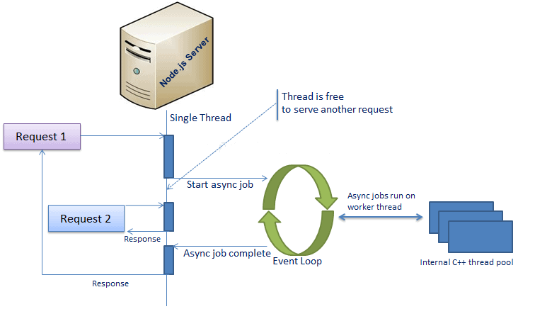
Node.js Execution Model
Introduction to Node.js
Asynchronous web server model using Node.js

Slide 7
Features of Node.js
Introduction to Node.js
Asynchronous and Event Driven
All APIs of Node.js library are asynchronous, that is, non-blocking.
It essentially means a Node.js based server never waits for an API to return data. The server moves to the next API after calling it.
A notification mechanism of Events of Node.js helps the server to get a response from the previous API call.
Very Fast
− Being built on Google Chrome's V8 JavaScript Engine, Node.js library is very fast in code execution.

Slide 8
Features of Node.js
Introduction to Node.js
Single Threaded but Highly Scalable
Node.js uses a single threaded model with event looping.
Event mechanism helps the server to respond in a non-blocking way and makes the server highly scalable as opposed to traditional servers which create limited threads to handle requests.
Node.js uses a single threaded program and the same program can provide service to a much larger number of requests than traditional servers like Apache HTTP Server.
No Buffering
Node.js applications never buffer any data. These applications simply output the data in chunks.

Slide 9
Advantages of Node.js
Introduction to Node.js
Node.js is an open-source framework under MIT license. MIT license is a free software license originating at the Massachusetts Institute of Technology (MIT).
Uses JavaScript to build entire server side application.
Lightweight framework that includes bare minimum modules. Other modules can be included as per the need of an application.
Asynchronous by default. So it performs faster than other frameworks.
Cross-platform framework that runs on Windows, MAC or Linux

Slide 10
Applications of Node.js
Introduction to Node.js
Node.js can be used efficiently in many kinds of applications.
Some of the most popular solutions includes,
IoT applications
real-time chats,
real-time collaboration tools,
streaming apps
Apps with micro services architecture
A large number of corporate giants have adopted Node.js application development like PayPal, LinkedIn, Netflix, Uber, GoDaddy, eBay, and so on.

Slide 11
Environment Setup
Introduction to Node.js
Node.js development environment can be setup in Windows, Mac, Linux and Solaris.
The following tools/SDK are required for developing a Node.js application on any platform,
Node.js
Node Package Manager (NPM)
- NPM (Node Package Manager) is included in Node.js installation
IDE (Integrated Development Environment) or Text Editor like Visual Code Editor
Node.js official web site https://nodejs.org.
It will automatically detect OS and display download link as per your Operating System.
Once the Node.js installed , can verify it by opening the command prompt and typing node -v.
If Node.js is installed successfully then it will display the version of the Node.js

Slide 12
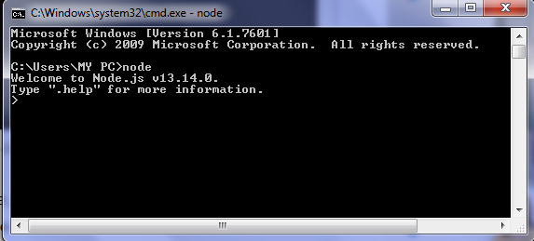
Node.js Console/REPL
Introduction to Node.js
Node.js comes with virtual environment called REPL (i.e Node shell).
REPL stands for Read-Eval-Print-Loop.
It is a quick and easy way to test simple Node.js/JavaScript code.
To launch the REPL (Node shell),
open command prompt (in Windows) or terminal (in Mac or UNIX/Linux)
type node
It will change the prompt to >.

Slide 13
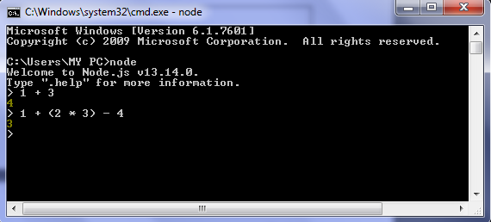
Node.js Console/REPL
Introduction to Node.js
Simple Expression
Let's try a simple mathematics at the Node.js REPL command prompt:

Slide 14
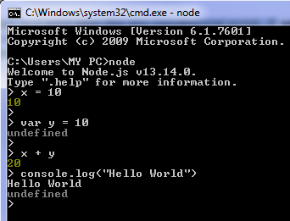
Node.js Console/REPL
Introduction to Node.js
Use Variables
We can make use variables to store values and print later like any conventional script.
If var keyword is not used, then the value is stored in the variable and printed.
If var keyword is used, then the value is stored but not printed.
We can print variables using console.log()

Slide 15
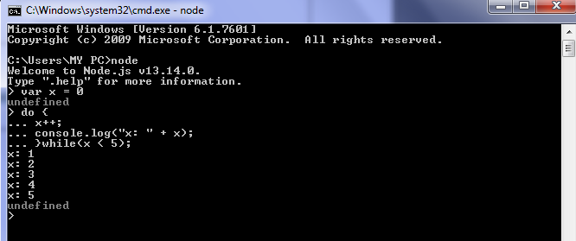
Node.js Console/REPL
Introduction to Node.js
Multiline Expression
Node REPL supports multiline expression similar to JavaScript.
Let's check the following do-while loop in action:

Slide 16
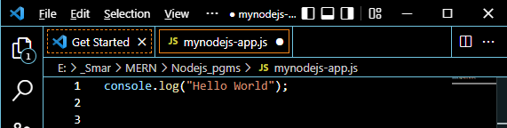
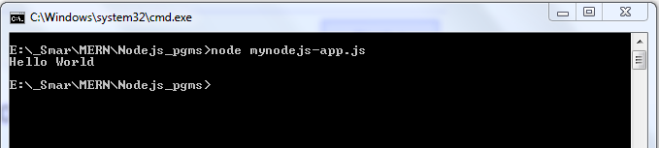
Node.js Console/REPL
Introduction to Node.js
To execute an external JavaScript file
Done by executing the node fileName command.
For example, the following runs mynodejs-app.js on the command prompt/terminal and displays the result.
Visual Code Editor
Command prompt

Slide 17
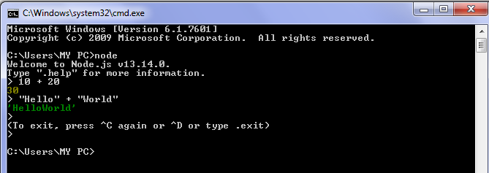
Node.js Console/REPL
Introduction to Node.js
Stopping REPL
To exit from the REPL terminal, press Ctrl + C twice or write .exit and press Enter.

Slide 18
Node.js Console/REPL
Introduction to Node.js
REPL Commands
REPL Command | Description
ctrl + c | Terminate the current command.
ctrl + c (twice) | Exit from the REPL.
ctrl + d | Exit from the REPL.
.break | Exit from multiline expression.
.clear | Exit from multiline expression.
.help | Display help on all the commands
tab Keys | Display the list of all commands.
Up/Down Keys | See previous commands applied in REPL.
.save filename | Save current Node REPL session to a file.
.load filename | Load the specified file in the current Node REPL session.

Slide 19
Node.js Fundamentals
Introduction to Node.js
Node.js supports JavaScript.
So, JavaScript syntax on Node.js is similar to the browser's JavaScript syntax.
Primitive Types: Node.js includes following primitive types
String
Number
Boolean
Undefined
Null
RegExp
Note: Everything else is an object in Node.js.

Slide 20
Node.js Fundamentals
Introduction to Node.js
Loose Typing
JavaScript in Node.js supports loose typing like the browser's JavaScript.
Use var, const or let keyword to declare a variable of any type.
Object Literal
Object literal syntax is same as browser's JavaScript.
var obj = {
authorName: 'Ryan Dahl',
language: 'Node.js'
}

Slide 21
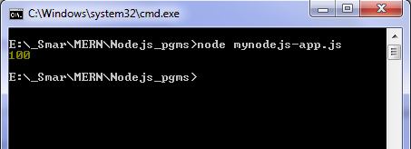
Node.js Fundamentals
Introduction to Node.js
Functions
Functions are first class citizens in Node's JavaScript, similar to the browser's JavaScript.
A function can have attributes and properties also.
Filename: app.js
function Display(x) {
console.log(x);
}
Display(100);

Slide 22
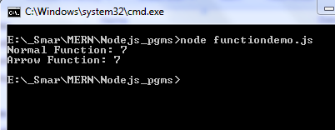
Node.js Fundamentals
Introduction to Node.js
Arrow Functions
Arrow functions allow us to write shorter function syntax:
Filename: app.js
function sum(a,b) {
return a+b;
}
var s = sum(3,4);
console.log("Normal Function: " + s);
var sum = (a,b) => {
return a+b;
}
var s = sum(3,4);
console.log("Arrow Function: " + s);

Slide 23
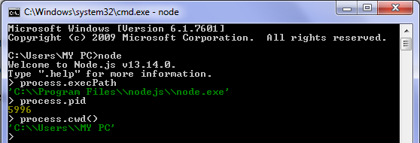
Node.js Fundamentals
Introduction to Node.js
Process object
Each Node.js script runs in a process.
It includes process object to get all the information about the current process of Node.js application.
The following example shows how to get process information in REPL using process object.

Slide 24
Node.js Local and Global Scope
Introduction to Node.js
Node's JavaScript is different from browser's JavaScript when it comes to global scope.
In the browser's JavaScript,
variables declared without var keyword become global.
In Node.js, everything becomes local by default.
In a browser, global scope is the window object.
In Node.js, global object represents the global scope.

Slide 25
Node.js Module system

Slide 26
Node.js Module
Node.js Module system
In Node.js, Modules are the blocks of encapsulated code that communicates with an external application on the basis of their related functionality.
Modules can be a single file or a collection of multiples files/folders.
The reason programmers are heavily reliant on modules is because of their re-usability as well as the ability to break down a complex piece of code into manageable chunks.

Slide 27
Node.js Module Types
Node.js Module system
Node.js includes three types of modules:
Core Modules
Local Modules
Third Party Modules

Slide 28
Node.js Core Modules
Node.js Module system
Node.js is a light weight framework.
Node.js comes with dozens of built-in modules.
These built-in modules, sometimes referred to as core modules, gives access to tools for working with the file system, making http requests, creating web servers, and more!
These core modules are compiled into its binary distribution and load automatically when Node.js process starts.
However, we need to import the core module first in order to use it in the application.

Slide 29
Node.js Core Modules
Node.js
Some of the important core modules in Node.js:
Core Module | Description | Properties and Methods URL
http | creates an HTTP server in Node.js. | https://nodejs.org/api/http.html
url | url module includes methods for URL resolution and parsing. | https://nodejs.org/api/url.html
querystring | querystring module includes methods to deal with query string. | https://nodejs.org/api/querystring.html
path | path module includes methods to deal with file paths. | https://nodejs.org/api/path.html
fs | used to handle file system. | https://nodejs.org/api/fs.html
util | util module includes utility functions useful for programmers. | https://nodejs.org/api/util.html

Slide 30
Importing Node.js Core Modules
Node.js Module system
In order to use Node.js core modules, first we need to import it using require() function.
As per above syntax, specify the module name in the require() function.
The require() function will return an object, function, property or any other JavaScript type, depending on what the specified module returns.
var module = require('module_name');

Slide 31
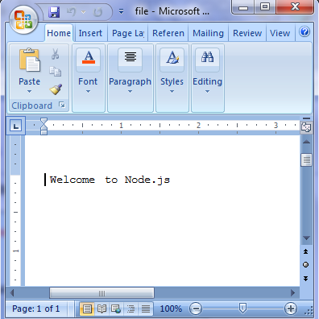
Importing Node.js Core Modules
Node.js Module system
In the below example,
The script above uses require to load in the fs module.
This is a built-in Node.js module that provides functions to manipulate the file system.
The script uses writeFileSync to write a message to file.txt.
Example 1 : Load and Use Core fs Module var fs = require(‘fs'); fs.writeFileSync(‘file.txt’ , ‘ Welcome to Node.js’);

Slide 32
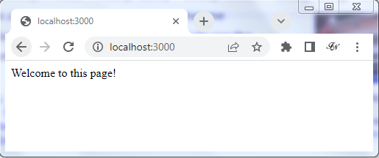
Importing Node.js Core Modules
Node.js Module system
In the below example,
require() function returns an object because http module returns its functionality as an object,
The function http.createServer() method will be executed when someone tries to access the computer on port 3000.
The res.writeHead() method is the status code where 200 means it is OK, while the second argument is an object containing the response headers.
Example 2: Load and Use Core http Module var http = require('http'); var server = http.createServer(function(req, res){ res.writeHead(200, {'Content-Type': 'text/html'}); res.write('Welcome to this page!'); res.end(); }).listen(3000);

Slide 33
Node.js Local Modules
Node.js Module system
Local modules are modules created locally in our Node.js application.
These modules include different functionalities of our application in separate files and folders.
To use local modules in our application,
we need to load it using require() function in the same way as core module.
require() is used to load in JavaScript files that we have created.
We need to provide require() with a relative path to the script we want to load.
This path should start with ./ and then link to the file that needs to be loaded in.

Slide 34
Node.js Local Modules
Node.js Module system
For example,
The code above uses require() to load in a file Message.js where it contains the message that need to be displayed.
So, we have specified the path './Message.js' in the require() function. The '.' denotes a root folder.
It stores the module contents in a variable msg, and then uses the contents in the script.
Filename: app.js var msg = require('./Message.js'); console.log(msg);

Slide 35
Node.js Export Module
Node.js Module system
Exporting from files
Node.js provides the required script with a place to store values that should be exported as part of the library. This is on module.exports.
The module.exports is a special object which is included in every JS file in the Node.js application by default.
Use module.exports or exports to expose a function, object or variable as a module in Node.js.
The value stored on module.exports will be the return value for require when the script is imported.

Slide 36
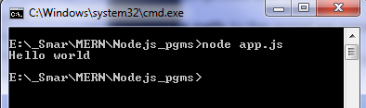
Node.js Export Module
Node.js Module system
The following example exposes simple string message as a module in Message.js.
If we run the app.js script, we will see the message “Hello World” is printed on console
Filename: Message.js module.exports = 'Hello world';

Slide 37
Node.js Local and Export Modules
Node.js Module system
For example, Create a calc.js file that has the following code.
Filename: calc.js exports.add = function (x, y) { return x + y; }; exports.sub = function (x, y) { return x - y; }; exports.mult = function (x, y) { return x * y; }; exports.div = function (x, y) { return x / y; };

Slide 38
Node.js Local and Export Modules
Node.js Module system
calc.js file provides attributes to the outer world via exports, another file can use its exported functionality using the require() function.
Filename: index.js var calculator = require('./calc'); var x = 50, y = 10; console.log("Addition of 50 and 10 is "+ calculator.add(x, y)); console.log("Subtraction of 50 and 10 is " + calculator.sub(x, y)); console.log("Multiplication of 50 and 10 is "+ calculator.mult(x, y)); console.log("Division of 50 and 10 is " + calculator.div(x, y));

Slide 39
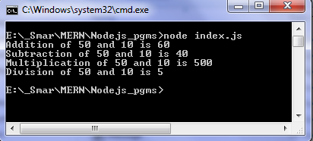
Node.js Local and Export Modules
Node.js Module system
Run index.js file using the following command:
node index.js

Slide 40
Third-party modules
Node.js Module system
Third party modules are modules that are available online using the Node Package Manager(NPM).
These modules can be installed in the project folder (locally) or globally.
NPM (Node Package Manager) is the default package manager for Node.js and is written entirely in Javascript.
It gets installed into the system with installation of Node.js. The required packages and modules in Node project are installed using NPM.
It is a command line tool that installs, updates or uninstalls Node.js packages.

Slide 41
Node Package Manager(NPM)
Node.js Module system
Installing NPM: To install NPM, it is required to install Node.js as NPM gets installed with Node.js automatically.
Checking and updating npm version:
Version of npm installed on system can be checked using the syntax
Older version of NPM can be updated to the latest version using the following command.
As npm is a global package, -g flag is used to update it globally.
npm –v
npm install npm@latest –g

Slide 42
Node Package Manager(NPM)
Node.js Module system
Creating a Node Project:
To create a Node project, npm init is used in the folder in which user want to create project.
The npm command line will ask a number of questions like name, license, scripts, description, author, keywords, version, main file etc.
After npm is done creating the project, a package.json file will be visible in project folder as a proof that the project has been initialized.
{ "name": "notes-app", "version": "1.0.0", "description": "", "main": "app.js", "scripts": { "test": "echo \"Error: no test specified\" && exit 1" }, "author": "", "license": "ISC", }

Slide 43
Node Package Manager(NPM)
Node.js Module system
Installing Packages:
After creating the project, next step is to incorporate the packages and modules to be used in the Node Project.
To install packages and modules in the project (locally) the following syntax:
NPM can also install packages globally so that all the node.js application on that computer can import and use the installed packages.
NPM installs global packages into /<User>/local/lib/node_modules folder.
Apply -g in the install command to install package globally. The syntax is
npm install <package_name>
npm install -g <package_name>

Slide 44
Node Package Manager(NPM)
Node.js Module system
Example: To install validator package, the syntax is:
This syntax does three important things:
First, it creates a node_modules directory.
npm uses this directory to store all the code for the npm modules that have installed.
Second, npm adds the module as a dependency by listing it in the dependencies property in package.json.
This allows to track and manage the module that have installed.
Third, npm creates a package-lock.json file.
This includes detailed information about the modules that have installed which helps keep things fast and secure
npm install validator

Slide 45
Node Package Manager(NPM)
Node.js Module system
Controlling where the package gets installed:
To install a package and simultaneously save it in package.json file (in case using Node.js), add –save flag.
The –save flag is default in npm install command so it is equal to npm install package_name command.
Importing an npm Module:
npm modules can be imported into your script using require() function.
To load in an npm module, pass the npm module name to require.
npm install validator –save

Slide 46
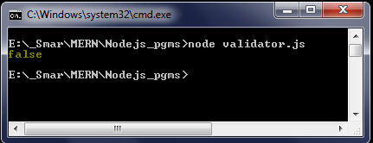
Node Package Manager(NPM)
Node.js Module system
The script above uses require() to load in validator.
The script then uses the isURL() function provided by validator to check if a given string contains a valid URL.
Filename: validator.js const validator = require('validator') console.log(validator.isURL('https/mead.io')) // Print: true

Slide 47
Node Package Manager(NPM)
Node.js Module system
Update Package:
To update the package installed locally, follow the below syntax:
Uninstalling Packages:
To uninstall packages using npm, follow the below syntax:
To uninstall global packages, follow the below syntax:
npm update <package name>
npm uninstall <package_name>
npm uninstall <package_name> -g

Slide 48
Node Package Manager(NPM)
Node.js Module system
Global npm Modules and nodemon
nodemon is a tool that helps develop node.js based applications by automatically restarting the node application when file changes in the directory are detected.
nodemon does not require any additional changes to the code or method of development.
nodemon is a replacement wrapper for node.
To use nodemon, replace the word node on the command line when executing the script.

Slide 49
Node Package Manager(NPM)
Node.js Module system
Installation: nodemon will be installed globally to our system path using below syntax:
It can also install nodemon as a development dependency:
Usage : nodemon wraps the application, so that we can pass all the arguments we would normally pass to our app:
npm install -g nodemon
npm install --save-dev nodemon
nodemon [your node app]

Slide 50
Node Package Manager(NPM)
Lets write an example index.js file that outputs the message: 'Welcome to Node.js!‘
Run index.js file using the command: nodemon index.js
Filename: index.js const http = require("http"); const server = http.createServer((req,res) => { res.writeHead(200, {'Content-Type': 'text/html'}); res.write('Welcome to Node.js!'); res.end(); }); server.listen(3000);

Slide 51
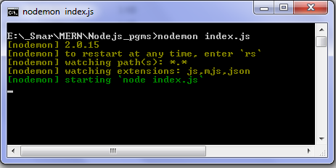
Node Package Manager(NPM)
The terminal output will display:
While nodemon is still running, let’s make a change to the index.js file.
Add a message: ‘Node.js is an open-source server side runtime environment.’.

Slide 52
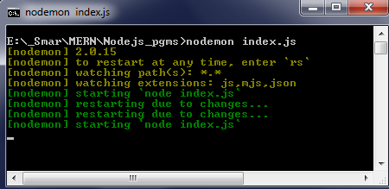
Node Package Manager(NPM)
The terminal output will display:
Filename: index.js const http = require("http"); const server = http.createServer((req,res) => { res.writeHead(200, {'Content-Type': 'text/html'}); res.write('Welcome to Node.js!'); res.write(‘Node.js is an open-source server side runtime environment.’); res.end(); }); server.listen(3000);

Slide 53
Node Package Manager(NPM)
Node.js Module system
The terminal output from the Node.js app is displaying the new changes.
We can restart the process at any time by typing rs and hitting ENTER.
Alternatively, nodemon will also look for a main file specified in our project’s package.json file:
Filename: package.json { // ... "main": “index.js", // ... }

Slide 54
Node Package Manager(NPM)
Node.js Module system
If a main file is not specified, nodemon will search for a start script:
Once we make the changes to package.json, we can then call nodemon to start the example app in watch mode without having to pass in index.js.
Filename: package.json { // ... "scripts": { "start": "node index.js" }, // ... }

Slide 55
Callback Concepts and Events

Slide 56
Callback Concepts
Callback Concepts and Events
A Callback is a function that is called automatically when a particular task is completed.
The Callback function allows the program to run other code until a certain task is not completed.
Callback is called when task get completed and is asynchronous equivalent for a function.
Using Callback concept, Node.js can process a large number of requests without waiting for any function to return the result which makes Node.js highly scalable.
For example,
In Node.js, when a function start reading file, it returns the control to execution environment immediately so that the next instruction can be executed.
Once file I/O gets completed, callback function will get called to avoid blocking or wait for File I/O.

Slide 57
Callback Concepts: Blocking Code (Synchronous)
Callback Concepts and Events
Lets write a example code for reading a file synchronously (blocking code) in Node.js.
Create a text file target.txt with the following content:
Filename: target.txt Node.js is an open-source, cross-platform, back-end JavaScript runtime environment that runs on the V8 engine and executes JavaScript code outside a web browser.

Slide 58
Callback Concepts: Blocking Code (Synchronous)
Callback Concepts and Events
Create a sync.js file with the following code:
In the above code,
fs library is loaded to handle file-system related operations.
The readFileSync() function is synchronous and blocks execution until finished.
The function blocks the program until it reads the file and then only it proceeds to end the program.
Filename: sync.js var fs = require("fs"); var filedata = fs.readFileSync(‘target.txt'); console.log(filedata.toString()); console.log("End of Program execution");

Slide 59
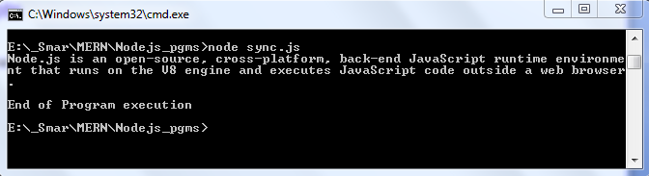
Callback Concepts: Blocking Code (Synchronous)
Callback Concepts and Events
The terminal output will display

Slide 60
Callback Concepts: Non - Blocking Code (Asynchronous)
Callback Concepts and Events
Lets write a example code for reading a file asynchronously (non-blocking code) in Node.js.
Create a text file target.txt with the following content.
Filename: target.txt Node.js is an open-source, cross-platform, back-end JavaScript runtime environment that runs on the V8 engine and executes JavaScript code outside a web browser.

Slide 61
Callback Concepts: Non - Blocking Code (Asynchronous)
Callback Concepts and Events
Create a async.js file with the following code:
Filename: async.js var fs = require("fs"); fs.readFile('target.txt', function (err, filedata) { if (err) { console.log(err); } console.log(filedata.toString()); }); console.log("End of Program execution");
fs library is loaded to handle file-system related operations.
The readFile() function is asynchronous and control return immediately to the next instruction in the program while the function keep running in the background.
The callback function that we have added receives two parameters, error and data. The error parameter becomes null when the file has been read successfully.

Slide 62
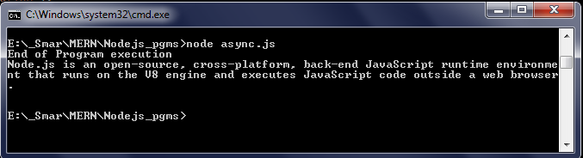
Callback Concepts: Non - Blocking Code (Asynchronous)
Callback Concepts and Events
The terminal output will display
Notice that the program, prints “End of Program execution” before printing the content of the file.
This is because the asynchronous function takes some time to complete hence the next statement which prints the “End of Program execution” finishes executing first.
As soon as the read file function finishes reading the file, the callback function is called and the necessary parameters are passed to it.

Slide 63
Callback Concepts: Non - Blocking Code (Asynchronous)
Callback Concepts and Events
Lets write a example code for reading a file asynchronously (non-blocking code) in Node.js.
Create a text file target.txt with the following content.
Filename: target.txt Node.js is an open-source, cross-platform, back-end JavaScript runtime environment that runs on the V8 engine and executes JavaScript code outside a web browser.

Slide 64
Events
Callback Concepts and Events
Each action on the computer is called an event.
In nodeJS objects can fire events.
Node.js has an ‘events’ module that emits named events, that can cause corresponding functions or callbacks to be called.
Functions(Callbacks) listen or subscribe to a particular event to occur, when that event triggers, all the callbacks subscribed to that event are fired one by one in order to which they were registered.

Slide 65
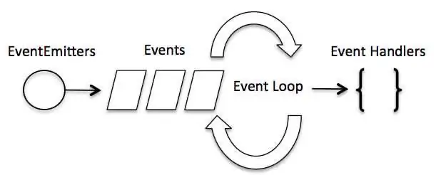
Event Driven Architecture
Callback Concepts and Events
Node.js is a single-threaded event-driven platform that is capable of running non-blocking, asynchronously programming.
Means as soon as Node starts its server, it simply initiates its variables, declares functions and then simply waits for event to occur.
It is the one of the reason why Node.js is pretty fast.
These functionalities of Node.js make it memory efficient.
There is a main loop in the event driven application that listens for events, and then triggers a callback function when one of those events is detected.

Slide 66
Event Loop
Callback Concepts and Events
The event loop allows Node.js to perform non-blocking I/O operations despite the fact that JavaScript is single-threaded.
It is done by assigning operations to the operating system whenever and wherever possible.
Features of Event Loop:
Event loop is an endless loop, which waits for tasks, executes them and then sleeps until it receives more tasks.
The event loop executes tasks from the event queue only when the call stack is empty i.e. there is no ongoing task.
The event loop allows to use callbacks.
The event loop executes the tasks starting from the oldest first.

Slide 67
Events vs. Callbacks
Callback Concepts and Events
Although, Events and Callbacks look similar but the differences lies in the fact that,
callback functions are called when an asynchronous function returns its result.
event handling works on the observer pattern.
Whenever an event gets fired, its listener function starts executing.
Node.js has multiple in-built events available through events module and EventEmitter class which is used to bind events and event listeners.
The EventEmmitter class: All objects that emit events are instances of the EventEmitter class.
The event can be emitted or listened to an event with the help of EventEmitter.

Slide 68
Events - Syntax
Callback Concepts and Events
Syntax for generating and firing events.
For creating a new event, EventEmitter class to bind event and event listener
For assigning any function to events. So, when this event is fired, the function gets executed.
For firing the events.
// Import events module var event = require(‘events’); // Create an eventEmitter object var eventEmitter = new event.EventEmitter();
// bind event handler with an event eventEmitter.on(‘eventName’,functionName);
// Fire an event eventEmitter.emit(‘eventName’);

Slide 69
EventEmitter class Methods
Callback Concepts and Events
EventEmitter Methods | Description
emitter.addListener(event,listener) | Add any listener to any event.
emitter.on(event,listener) | Alias of emitter.addListener()
emitter.once(event,listener) | Add one time listener to any event
emitter.removeListener(event, listener) | Remove listener from any event.
emitter.off(event,listener) | Alias of emitter.removeListener()
emitter.removeAllListeners([event]) | Remove all listeners from any event
listeners(event) | Get list of all the listeners of any event.

Slide 70
EventEmitter class Methods
Callback Concepts and Events
EventEmitter Methods | Description
emitter.setMaxListeners(n) | Set maximum limit for listener on any event. Print a warning if more than 10 listeners are added for a particular event.
emitter.getMaxListeners() | Returns the current maximum listener value for the emitter which is either set by emitter.setMaxListeners(n)
emitter.emit(event[, arg1][, arg2][, ...]) | Raise the specified events with the supplied arguments.
emitter.listenerCount(type) | Returns the number of listeners listening to the type of event.

Slide 71
Event - Example
Callback Concepts and Events
In this example,
First we load the “events” module, using the require method.
In the next line, we generate an instance of EventEmitter class.
Further, we create a fun function and bind this function on the “Hello” event, using the “on” method of EventEmitter class.
It means, when “Hello” event will fire, “fun” function will call.
In the last line, we Emit the “Hello” event and in the form of output, “fun” function is called and “Hello! Event” message is printed.
Filename: Event_Ex1.js //load Event Module var event = require('events'); //Create New Event Emitter var eventEmitter = new event.EventEmitter(); //Create a function var fun = function() { console.log("Hello! Event"); }; //Bind 'fun' function to Hello Event eventEmitter.on('Hello',fun); //Emit Hello Event eventEmitter.emit('Hello');

Slide 72
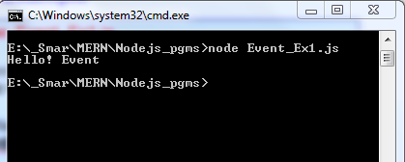
Event - Example
Callback Concepts and Events
Run the command node Event_Ex1.js in the terminal.
The terminal output will display the message “Hello! Event”.

Slide 73
Event - Example
Callback Concepts and Events
Filename: Event_Ex2.js //load Event Module var event = require('events'); //Create New Event Emitter var eventEmitter = new event.EventEmitter(); //Create function1 var fun1 = function() { console.log("Hello! Event"); }; //Create function2 var fun2 = function() { console.log("Hello! Nodejs"); }; //Create function3 var fun3 = function() { console.log("Hello! JavaScript"); };
//Bind 'fun' function to Hello Event eventEmitter.on('Hello',fun1); eventEmitter.on('Hello',fun2); eventEmitter.on('Hello',fun3); //Emit Hello Event eventEmitter.emit('Hello');
In this example,
We bind three functions for a single event, so all these functions will call synchronously.

Slide 74
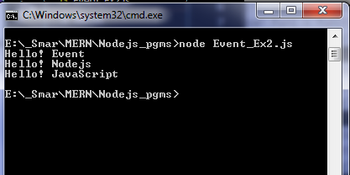
Event - Example
Callback Concepts and Events
Run the command node Event_Ex2.js in the terminal.
The terminal output will display:

Slide 75
Event - Example
Callback Concepts and Events
Filename: Event_Ex3.js //load Event Module var event = require('events'); //Create New Event Emitter var eventEmitter = new event.EventEmitter(); //Create function1 var fun1 = function() { console.log("Hello! Event"); }; //Create function2 var fun2 = function() { console.log("Hello! Nodejs"); }; //Create function3 var fun3 = function() { console.log("Hello! JavaScript"); };
//Bind 'fun' function to Hello Event eventEmitter.on('Hello',fun1); eventEmitter.on('Hello',fun2); eventEmitter.on('Hello',fun3); //Emit Hello Event setInterval(function() { eventEmitter.emit('Hello'); },1000)
In this example,
We create a set interval of 1000ms.
After each 1000ms, “hello” event will fire and all the functions attached to this event will execute.

Slide 76
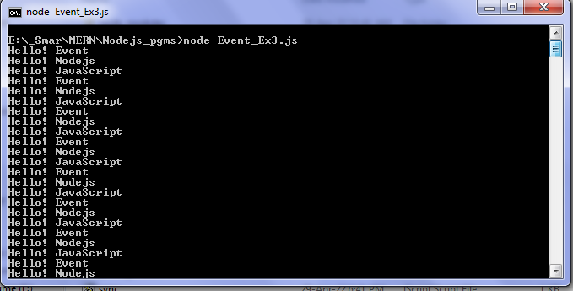
Event - Example
Callback Concepts and Events
Run the command node Event_Ex3.js in the terminal.
The terminal output will display:

Slide 77
Event - Passing Arguments to Listeners
Callback Concepts and Events
Filename: Event_Arg.js //load Event Module var event = require('events'); //Create New Event Emitter var eventEmitter = new event.EventEmitter(); //Create a function var fun = function(name,city) { console.log("Hello! My Name is "+ name +" and City is "+ city); }; //Bind 'fun' function to Hello Event eventEmitter.on('Info',fun); //Emit Hello Event eventEmitter.emit('Info','John','Ottawa'); eventEmitter.emit('Info','Mark','Winnipeg'); eventEmitter.emit('Info','Glad','Edmonton'); eventEmitter.emit('Info','Smith','Montreal');
In this example,
We create a fun method, which takes two arguments and binds this function to “info” event of eventEmitter.
Thus, when we emit info event, we need to pass the two arguments; i.e., name and city.

Slide 78
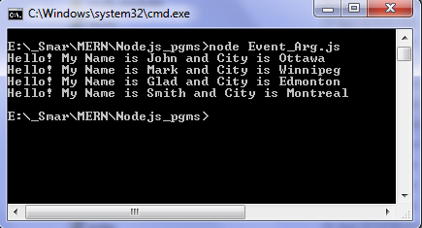
Event - Passing Arguments to Listeners
Callback Concepts and Events
Run the command node Event_Arg.js in the terminal.
The terminal output will display:

Slide 79
Event - Invoke Events Once
Callback Concepts and Events
Filename: Event_Arg.js //load Event Module var event = require('events'); //Create New Event Emitter var eventEmitter = new event.EventEmitter(); //Create a function var fun = function(name,city) { console.log("Hello! My Name is "+ name +" and City is "+ city); }; //Bind 'fun' function to Hello Event eventEmitter.once('Info',fun); //Emit Hello Event eventEmitter.emit('Info','John','Ottawa'); eventEmitter.emit('Info','Mark','Winnipeg'); eventEmitter.emit('Info','Glad','Edmonton'); eventEmitter.emit('Info','Smith','Montreal');
In this example,
Using “eventEmitter.once” method, it is possible to register an event listener, which will be invoked only one time.
we invoked “info” event four times, but the event listener executed only once.

Slide 80
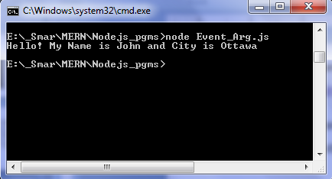
Event - Invoke Events Once
Callback Concepts and Events
Run the command node Event_Arg.js in the terminal.
The terminal output will display:

Slide 81
Event - Maximum Listener
Callback Concepts and Events
Filename: Event_maxlistener.js //load Event Module var event = require('events'); //Create New Event Emitter var eventEmitter = new event.EventEmitter(); console.log(eventEmitter.getMaxListeners()); eventEmitter.setMaxListeners(20); console.log("Maximum eventListener has changed"); console.log(eventEmitter.getMaxListeners());
In this example,
By default, 10 eventListener can be added for an event, but we can change this number, using the setMaxListeners(n) method and getMaxListeners() method can be used to get the numbers of the maximum listeners for an event.

Slide 82
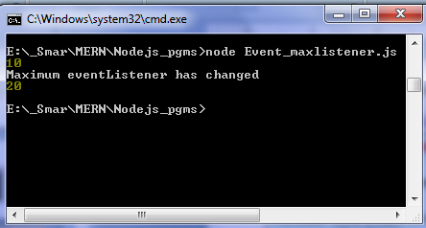
Event - Maximum Listener
Callback Concepts and Events
Run the command node Event_maxlistener.js in the terminal.
The terminal output will display:

Slide 83
Event – Listener Count
Callback Concepts and Events
Filename: Event_ListenerCount.js //load Event Module var event = require('events'); //Create New Event Emitter var eventEmitter = new event.EventEmitter(); eventEmitter.on('Call', function() { console.log("This is Call Event") }); eventEmitter.on('Call', function() { console.log("This is Call Event2") }); eventEmitter.emit('Call'); console.log(eventEmitter.listenerCount('Call'));
In this example,
This method returns the numbers of the listeners added for a given event.

Slide 84
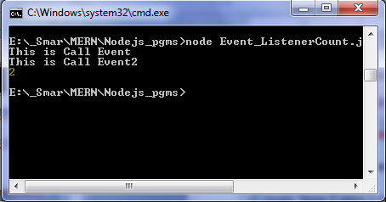
Event - Listener Count
Callback Concepts and Events
Run the command node Event_ListenerCount.js in the terminal.
The terminal output will display:

Slide 85
Event – addListener() and removeListener()
Callback Concepts and Events
Filename: Events_Rem.js //load Event Module var event = require('events'); //Create New Event Emitter var eventEmitter = new event.EventEmitter(); // Declaring listener fun to myEvent var fun = function(msg){ console.log("Message from fun: " + msg); }; //Add Listener eventEmitter.addListener('myEvent', fun); eventEmitter.emit('myEvent', 'Event occurred'); // Remove Listener eventEmitter.removeListener('myEvent'); eventEmitter.emit('myEvent');
AddListener(even, listener)
The AddListener method is the method I used to add a listener for an event.
removeListener(event, listener) and removeAllListeners();
removeListener method is used to remove a listener, attached with an event and removeAllListener is used to remove all the listeners attached with a event.

Slide 86
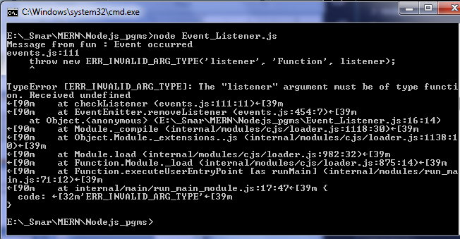
Event – addListener() and removeListener()
Callback Concepts and Events
Run the command node Events_Listener.js in the terminal.
When we execute this program, we get the error because we remove the “myEvent” listener and afterwards, we are trying to emit an event.
The terminal output will display:

Slide 87
Event – on() and off()
Callback Concepts and Events
Filename: Events_Rem.js //load Event Module var event = require('events'); //Create New Event Emitter var eventEmitter = new event.EventEmitter(); // Declaring listener fun1 to myEvent1 var fun1 = function(msg){ console.log("Message from fun1: " + msg); }; // Declaring listener fun2 to myEvent2 var fun2 = function(msg){ console.log("Message from fun2: " + msg); };
// Listening to myEvent with fun1 and fun2 eventEmitter.on('myEvent', fun1); eventEmitter.on('myEvent', fun2); // Removing listener eventEmitter.off('myEvent', fun1); // Triggering myEvent eventEmitter.emit('myEvent', 'Event occurred');
In this example,
We create two fun method, which takes one argument and binds this function to “myEvent” event of eventEmitter.
eventEmitter.off() method removes the listener

Slide 88
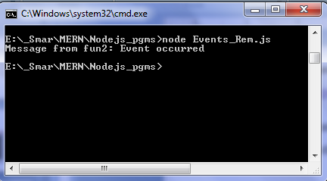
Event – on() and off()
Callback Concepts and Events
Run the command node Events_Rem.js in the terminal.
The terminal output will display the message from fun2 and fun1 is removed.

Slide 89
Node.js File System

Slide 90
File System
NodeJS File System
To handle file operations like creating, reading, deleting, etc., Node.js provides an inbuilt module called fs (File System).
Node.js includes fs module to access physical file system.
The fs module is responsible for all the asynchronous or synchronous file I/O operations.
To use this File System module, use the require() method.
The Node File System (fs) module can be imported using the following syntax −
var fs = require("fs")

Slide 91
File System Methods
Method | Description
fs.readFile(fileName [,options], callback) | Reads existing file.
fs.writeFile(filename, data[, options], callback) | Writes to the file. If file exists then overwrite the content otherwise creates new file.
fs.appendFile(file, data[, options], callback) | Appends new content to the existing file.
fs.open(path, flags[, mode], callback) | Opens file for reading or writing.
fs.rename(oldPath, newPath, callback) | Renames an existing file.
fs.exists(path, callback) | Determines whether the specified file exists or not.
fs.mkdir(path[, mode], callback) | Creates a new directory.
fs.rmdir(path, callback) | Renames an existing directory.
fs.readdir(path, callback) | Reads the content of the specified directory.

Slide 92
File System Methods
Method | Description
fs.access(path[, mode], callback) | Tests a user's permissions for the specified file.
fs.utimes(path, atime, mtime, callback) | Changes the timestamp of the file.
fs.chown(path, uid, gid, callback) | Asynchronous chown.
fs.stat(path, callback) | Returns fs.stat object which includes important file statistics.
fs.link(srcpath, dstpath, callback) | Links file asynchronously.
fs.symlink(destination, path[, type], callback) | Symlink asynchronously.
fs.unlink(path, callback) | Delete a file.

Slide 93
Synchronous vs Asynchronous
NodeJS File System
Synchronous approach:
They are called blocking functions as it waits for each operation to complete, only after that, it executes the next operation, hence blocking the next command from execution i.e. a command will not be executed until & unless the query has finished executing to get all the result from previous commands.
Asynchronous approach:
They are called non-blocking functions as it never waits for each operation to complete, rather it executes all operations in the first go itself.
The result of each operation will be handled once the result is available i.e. each command will be executed soon after the execution of the previous command.
While the previous command runs in the background and loads the result once it is finished processing the data.

Slide 94
Node.js FS Reading File
NodeJS File System
Use fs.readFile() method to read the physical file asynchronously.
Parameter Description:
filename: Full path and name of the file as a string.
options: The options parameter can be an object or string which can include encoding and flag. The default encoding is utf8 and default flag is "r".
callback: A function with two parameters err and fd. This will get called when readFile operation completes.
fs.readFile(fileName [,options], callback)

Slide 95
Node.js FS Reading File
NodeJS File System
Example that demonstrates reading existing TestFile.txt synchronously and asynchronously
Filename: Reading_File.js var fs = require("fs"); // Asynchronous read fs.readFile('TestFile.txt', function (err, data) { if (err) throw err; console.log("Asynchronous read: " + data.toString()); }); // Synchronous read var data = fs.readFileSync('TestFile.txt'); console.log("Synchronous read: " + data.toString()); console.log("Program Ended");
In Asynchronous read,
TestFile.txt read asynchronously and executes callback function until read operation completes.
This read operation either throws an error or completes successfully.
The err parameter contains error information if any.
The data parameter contains the content of the specified file.
In Synchronous read,
Use fs.readFileSync() method to read file synchronously.

Slide 96
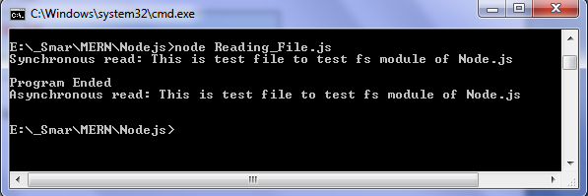
Node.js FS Reading File
NodeJS File System
The following is a sample TextFile.txt file.
Run the command node Reading_File.js in the terminal.
The terminal output will display
Filename: TestFile.txt This is test file to test fs module of Node.js

Slide 97
Node.js FS Writing File
NodeJS File System
Use fs.writeFile() method to write data to a file.
If file already exists then it overwrites the existing content otherwise it creates a new file and writes data into it.
Parameter Description:
filename: Full path and name of the file as a string.
Data: The content to be written in a file.
options: The options parameter can be an object or string which can include encoding, mode and flag. The default encoding is utf8 and default flag is "r".
callback: This is the callback function which gets a single parameter err that returns an error in case of any writing error.
fs.writeFile(filename, data[, options], callback)

Slide 98
Node.js FS Writing File
NodeJS File System
Lets write an example that creates a new file called test.txt and writes "Hello World" into it asynchronously.
Filename: Writing_File.js var fs = require('fs'); fs.writeFile('test.txt', 'Hello World!', function (err) { if (err) throw err; console.log('Write operation complete.'); });

Slide 99
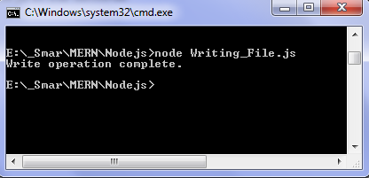
Node.js FS Writing File
NodeJS File System
Run the command node Writing_File.js in the terminal.
The terminal output will display
A new file called test.txt created and “HelloWorld!” is written in the file
Filename: test.txt Hello World!

Slide 100
Node.js FS Appending File Content
NodeJS File System
Use fs.appendFile() method to append the content to an existing file.
Parameter Description:
filename: Full path and name of the file as a string.
Data: The content to be appended to an existing file.
options: The options parameter can be an object or string which can include encoding, mode and flag. The default encoding is utf8 and default flag is "r".
callback: This is the callback function which gets a single parameter err that returns an error in case of any writing error.
fs.appendFile(filename, data[, options], callback)

Slide 101
Node.js FS Appending File Content
NodeJS File System
Lets write an example that append the content “Welcome to NodeJS" into a existing file test.txt.
Filename: Append_File.js var fs = require('fs'); fs.appendFile('test.txt', ‘ Welcome to Node JS', function (err) { if (err) throw err; console.log(‘Append operation complete.'); });

Slide 102
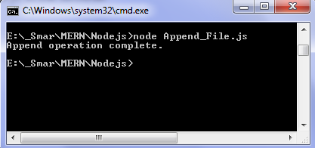
Node.js FS Appending File Content
NodeJS File System
Run the command node Append_File.js in the terminal.
The terminal output will display
Open the test.txt file and notice the content “Welcome to NodeJS ” is appended in the file
Filename: test.txt Hello World! Welcome to NodeJS

Slide 103
Node.js FS Open File
NodeJS File System
Use fs.appendFile() method to open a file for reading or writing.
Parameter Description:
path: Full path with name of the file as a string.
Flag: The flag to perform operation
Mode: The mode for read, write or readwrite. Defaults to 0666 readwrite.
callback: A function with two parameters err and fd. This will get called when file open operation completes.
fs. open(path, flags[, mode], callback)

Slide 104
Node.js FS Open File - Flags
NodeJS File System
The following table lists all the flags which can be used in read/write operation.
Flag | Description
r | Open file for reading. An exception occurs if the file does not exist.
r+ | Open file for reading and writing. An exception occurs if the file does not exist.
rs | Open file for reading in synchronous mode.
rs+ | Open file for reading and writing, telling the OS to open it synchronously.
w | Open file for writing. The file is created (if it does not exist) or truncated (if it exists).
wx | Like 'w' but fails if path exists.
w+ | Open file for reading and writing. The file is created (if it does not exist) or truncated (if it exists).
wx+ | Like 'w+' but fails if path exists.
a | Open file for appending. The file is created if it does not exist.
ax | Like 'a' but fails if path exists.
a+ | Open file for reading and appending. The file is created if it does not exist.
ax+ | Like 'a+' but fails if path exists.

Slide 105
Node.js FS Open File
NodeJS File System
Lets write an example that opens an existing file in read mode.
Filename: Open_File.js var fs = require("fs"); // Asynchronous - Opening File console.log("Going to open file!"); // Open file input.txt in read mode fs.open('input.txt', 'r+', function(err, fd) { if (err) throw err; console.log("File opened successfully!"); });

Slide 106
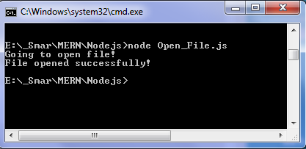
Node.js FS Open File
NodeJS File System
Run the command node Open_File.js in the terminal.
The terminal output will display
The file is opened and the flag is set to read mode. After opening of file function is called to read the contents of file and store in memory. As there are no errors ‘File opened successfully!’ is printed.

Slide 107
Node.js FS Open File
NodeJS File System
Lets write an example that opens an existing file in write and read mode.
Filename: Open_File1.js var fs = require('fs'); console.log("Open file!"); // To open file in write and read mode, // create file if doesn't exists. fs.open('input.txt', 'w+', function (err, fdata) { if (err) throw err; console.log("File opened successfully!"); });

Slide 108
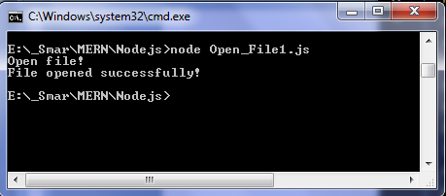
Node.js FS Open File
NodeJS File System
Run the command node Open_File1.js in the terminal.
The terminal output will display
The file ‘demo.txt’ is opened in read and write mode, then the function is called.
As there are no errors ‘File opened successfully!’ is printed.

Slide 109
Node.js FS Get File Information
NodeJS File System
Use fs.stat() method to get the information about a file −
Parameter Description:
path: Full path with name of the file as a string.
callback: This is the callback function which gets two arguments (err, stats) where stats is an object of fs.stats type.
fs.stat(path, callback)

Slide 110
Node.js FS Get File Information
NodeJS File System
The following methods in fs.stats class which can be used to check file type.
Method | Description
stats.isFile() | Returns true if file type of a simple file.
stats.isDirectory() | Returns true if file type of a directory.
stats.isBlockDevice() | Returns true if file type of a block device.
stats.isCharacterDevice() | Returns true if file type of a character device.
stats.isSymbolicLink() | Returns true if file type of a symbolic link.
stats.isFIFO() | Returns true if file type of a FIFO.
stats.isSocket() | Returns true if file type of asocket.

Slide 111
Node.js FS Get File Information
NodeJS File System
Lets write an example that get the information about a file and be used to check file type.
Filename: stat.js var fs = require("fs"); console.log("Going to get file info!"); fs.stat('input.txt', function (err, stats) { if (err) throw err; console.log(stats); console.log("Got file info successfully!"); // Check file type console.log("isFile ? " + stats.isFile()); console.log("isDirectory ? " + stats.isDirectory()); });

Slide 112
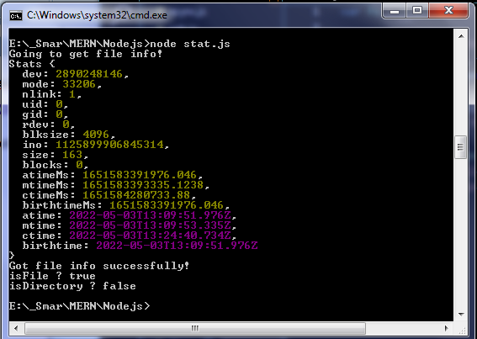
Node.js FS Get File Information
NodeJS File System
Run the command node stat.js in the terminal.
The terminal output will display

Slide 113
Node.js FS Create a Directory
NodeJS File System
Use fs.mkdir() method to create a directory.
Parameter Description:
path − This is the directory name including path.
mode − This is the directory permission to be set. Defaults to 0777.
callback − This is the callback function No arguments other than a possible exception are given to the completion callback.
fs.mkdir(path[, mode], callback)

Slide 114
Node.js FS Create a Directory
NodeJS File System
Lets write an example that create a directory.
Filename: Create_Directory.js var fs = require("fs"); console.log("Going to create directory /test"); fs.mkdir('E:/_Smar/MERN/Nodejs/test',function(err) { if (err) throw err; console.log("Directory created successfully!"); });

Slide 115
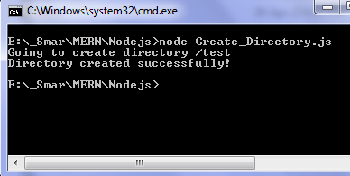
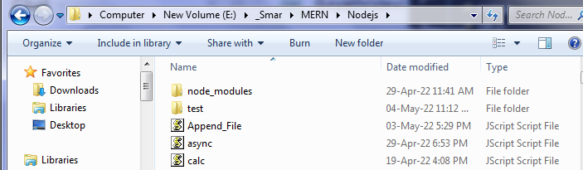
Node.js FS Create a Directory
NodeJS File System
Run the command node Create_Directory.js in the terminal.
The terminal output will display
/test directory is created in the given path

Slide 116
Node.js FS Read a Directory
NodeJS File System
Use fs.readdir() method to read a directory .
Parameter Description:
path − This is the directory name including path.
callback − This is the callback function which gets two arguments (err, files) where files is an array of the names of the files in the directory excluding '.' and '..'.
fs.readdir(path, callback)

Slide 117
Node.js FS Read a Directory
NodeJS File System
Lets write an example that read a directory.
Filename: Read_Directory.js var fs = require("fs"); console.log("Going to read directory /Nodejs"); fs.readdir("E:/_Smar/MERN/Nodejs/",function(err, files) { if (err) throw err; files.forEach( function (file) { console.log( file ); }); });

Slide 118
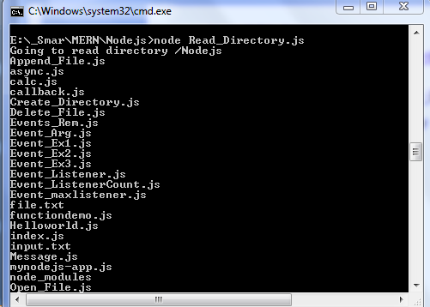
Node.js FS Read a Directory
NodeJS File System
Run the command node Read_Directory.js in the terminal.
The terminal output will display all the files in /Nodejs directory

Slide 119
Node.js FS Remove a Directory
NodeJS File System
Use fs.rmdir() method to remove a directory.
Parameter Description:
path − This is the directory name including path.
callback − This is the callback function No arguments other than a possible exception are given to the completion callback.
fs.rmdir(path, callback)

Slide 120
Node.js FS Remove a Directory
NodeJS File System
Lets write an example that remove a directory.
Filename: Remove_Directory.js var fs = require("fs"); console.log("Going to delete directory /test"); fs.rmdir("E:/_Smar/MERN/Nodejs/test",function(err) { if (err) throw err; console.log("Going to read directory /Nodejs"); fs.readdir("E:/_Smar/MERN/Nodejs/",function(err, files) { if (err) { return console.error(err); } files.forEach( function (file) { console.log( file ); }); }); });

Slide 121
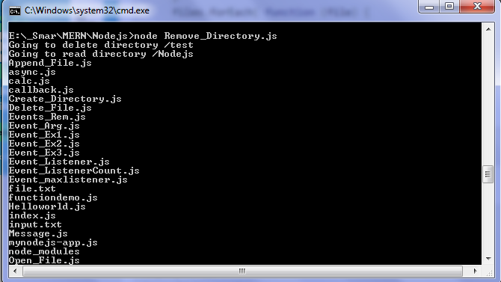
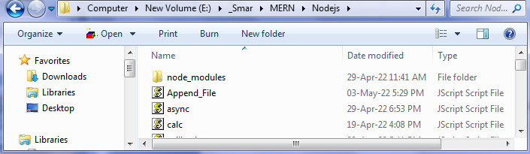
Node.js FS Remove a Directory
NodeJS File System
Run the command node Remove_Directory.js in the terminal.
The terminal output will display
/test directory is removed from the given path
/test directory
is removed

Slide 122
Node.js FS Rename File
NodeJS File System
Use fs.rename() method to rename a specified file.
Parameter Description:
path: Full path with name of the file as a string.
callback: This is the callback function No arguments other than a possible exception are given to the completion callback.
fs.rename(path, callback)

Slide 123
Node.js FS Rename File
NodeJS File System
Lets write an example that rename a specified file.
Filename: Rename_File.js var fs = require('fs'); fs.rename('input.txt', 'renamed_input_file.txt', function (err) { if (err) throw err; console.log('File Renamed!'); });

Slide 124
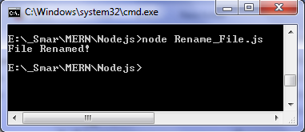
Node.js FS Rename File
NodeJS File System
Run the command node Rename_File.js in the terminal.
The terminal output will display

Slide 125
Node.js FS Delete File
NodeJS File System
Use fs.unlink() method to delete an existing file.
Parameter Description:
path: Full path with name of the file as a string.
callback: This is the callback function No arguments other than a possible exception are given to the completion callback.
fs.unlink(path, callback)

Slide 126
Node.js FS Delete File
NodeJS File System
Lets write an example that delete an existing file.
Filename: Delete_File.js var fs = require("fs"); console.log("Going to delete an existing file"); fs.unlink('input.txt', function(err) { if (err) throw err; console.log("File deleted successfully!"); });

Slide 127
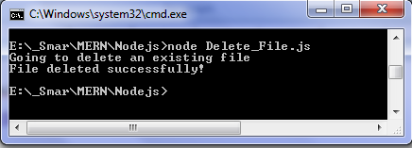
Node.js FS Delete File
NodeJS File System
Run the command node Delete_File.js in the terminal.
The terminal output will display

Slide 128
Node.js Web Server

Slide 129
Node.js Web Server
NodeJS Web Server
Node.js is an open source server environment.
Node.js uses JavaScript on the server.
The task of a web server is to open a file on the server and return the content to the client.
To access web pages of any web application, we need a web server.
The web server will handle all the http requests for the web application
Node.js provides capabilities to create our own web server which will handle HTTP requests asynchronously.
We can use IIS or Apache to run Node.js web application but it is recommended to use Node.js web server.

Slide 130
Node.js Web Server
NodeJS Web Server
Node.js makes it easy to create a simple web server that processes incoming requests asynchronously.
Node.js has a built-in module called HTTP, which allows Node.js to transfer data over the Hyper Text Transfer Protocol (HTTP).
The HTTP module can create an HTTP server that listens to server ports and gives a response back to the client.

Slide 131
Create Node.js Web Server
NodeJS Web Server
The following example is a simple Node.js web server contained in server.js file.
Filename: server.js var http = require('http'); // 1 - Import Node.js core module var server = http.createServer(function (req, res) { // 2 - creating server //handle incomming requests here.. }); server.listen(3000); // 3 - listen for any incoming requests console.log('Node.js web server at port 3000 is running..')

Slide 132
Create Node.js Web Server
NodeJS Web Server
In the given example,
We import the http module using require() function.
The http module is a core module of Node.js, so no need to install it using NPM.
The next step is to call createServer() method of http and specify callback function with request and response parameter.
Finally, call listen() method of server object which was returned from createServer() method with port number, to start listening to incoming requests on port 3000.
We can specify any unused port here.

Slide 133
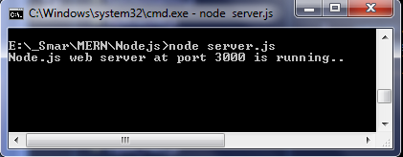
Create Node.js Web Server
NodeJS Web Server
Run the command node server.js in the terminal.
The terminal output will display

Slide 134
Handling HTTP Request
NodeJS Web Server
The http.createServer() method includes request and response parameters which is supplied by Node.js.
The request object can be used to get information about the current HTTP request e.g., url, request header, and data.
The response object can be used to send a response for a current HTTP request.

Slide 135
Handling HTTP Request
NodeJS Web Server
The following example demonstrates handling HTTP request and response in Node.js.
Filename: server.js var http = require('http'); // Import Node.js core module var server = http.createServer(function (req, res) { //create web server if (req.url == '/') { //check the URL of the current request // set response header res.writeHead(200, { 'Content-Type': 'text/html' }); // set response content res.write('<html><body><p>This is Home page.</p></body></html>'); res.end(); } else if (req.url == "/admin") { res.writeHead(200, { 'Content-Type': 'text/html' }); res.write('<html><body><p>This is Admin page.</p></body></html>'); res.end(); }

Slide 136
Handling HTTP Request
NodeJS Web Server
else if (req.url == "/employee") { res.writeHead(200, { 'Content-Type': 'text/html' }); res.write('<html><body><p>This is Employee page.</p></body></html>'); res.end(); } else res.end('Invalid Request!'); }); server.listen(3000); // listen for any incoming requests console.log('Node.js web server at port 3000 is running..')

Slide 137
Handling HTTP Request
NodeJS Web Server
In the given example,
req.url is used to check the url of the current request and based on that it sends the response.
To send a response, first it sets the response header using writeHead() method and then writes a string as a response body using write() method.
Finally, Node.js web server sends the response using end() method.

Slide 138
Handling HTTP Request
NodeJS Web Server
Run the command node server.js in the terminal.
The terminal output will display

Slide 139
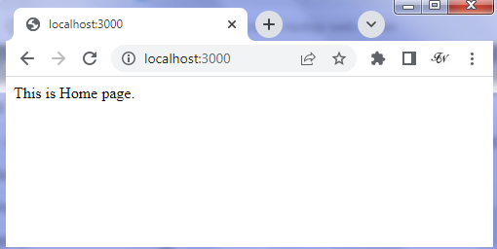
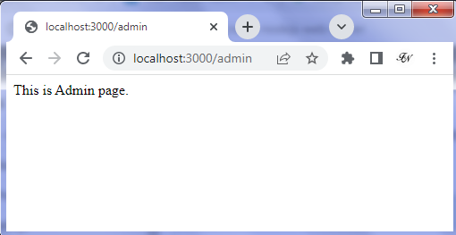
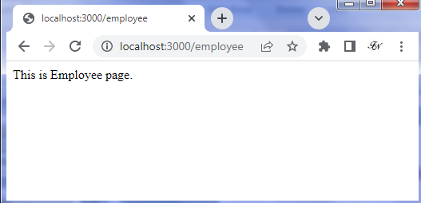

Handling HTTP Request
NodeJS Web Server
Point the browser to http://localhost:3000 and see the Node.js Web Server Response.
/home url is not specified. So it displays "Invalid Request" for all requests other than the specified URLs.

Slide 140
Sending JSON Response
NodeJS Web Server
The following example demonstrates how to serve JSON response from the Node.js web server.
Filename: server_json.js var http = require('http'); var server = http.createServer(function (req, res) { if (req.url == '/data') { //check the URL of the current request res.writeHead(200, { 'Content-Type': 'application/json' }); res.write(JSON.stringify({ message: "Hello World"})); res.end(); } }); server.listen(3000); console.log('Node.js web server at port 3000 is running..')

Slide 141


Sending JSON Response
NodeJS Web Server
Run the command node server.js in the terminal.
The terminal output will display
Point the browser to http://localhost:3000/data and see the Node.js Web Server Response.
JSON response from the Node.js web server

Slide 142
Frameworks for Node.js

Slide 143
Node Framework
Frameworks for NodeJS
A framework is a collection of various libraries and tools that are required in the development process of a software application.
It acts as a base on which different software applications can be developed.
A node framework is a workspace platform that supports the use of Node.js and which allows developers to use JavaScript for developing front end as well as the back end of an application.
Node frameworks are a wide collection of frameworks built on Node and that extend its properties and functionalities further.

Slide 144
Node Framework
Frameworks for NodeJS
Benefits of Node Framework
Productivity
Scalability
Speed
Same Languages for Front-end and Back-end
Maintaining Code standards across a team

Slide 145
Frameworks for NodeJS
Frameworks for NodeJS
There are various third party open-source frameworks available in Node Package Manager which makes Node.js application development faster and easy.
We can choose an appropriate framework as per our application requirements.
The following table lists frameworks for Node.js.

Slide 146
Frameworks for NodeJS
Frameworks for NodeJS
Open-Source Framework | Description
Express.js | Express is a minimal and flexible Node.js web application framework that provides a robust set of features for web and mobile applications. This is the most popular framework as of now for Node.js.
Geddy | Geddy is a simple, structured web application framework for Node.js based on MVC architecture.
Hapi.js | Hapi is a rich Node.js framework for building applications and services.
Locomotive | Locomotive is MVC web application framework for Node.js. It supports MVC patterns, RESTful routes, and convention over configuration, while integrating seamlessly with any database and template engine. Locomotive builds on Express, preserving the power and simplicity you've come to expect from Node.
Koa | Koa is a new web framework designed by the team behind Express, which aims to be a smaller, more expressive, and more robust foundation for web applications and APIs.
Total.js | Totaljs is free web application framework for building web sites and web applications using JavaScript, HTML and CSS on Node.js
Keystone | Keystone is the open source framework for developing database-driven websites, applications and APIs in Node.js. Built on Express and MongoDB.

Slide 147
Frameworks for NodeJS
Frameworks for NodeJS
Open-Source Framework | Description
Derbyjs | Derby support single-page apps that have a full MVC structure, including a model provided by Racer, a template and styles based view, and controller code with application logic and routes.
Sails.js | Sails makes it easy to build custom, enterprise-grade Node.js apps. It is designed to emulate the familiar MVC pattern of frameworks like Ruby on Rails, but with support for the requirements of modern apps: data-driven APIs with a scalable, service-oriented architecture. It's especially good for building chat, realtime dashboards, or multiplayer games; but you can use it for any web application project - top to bottom.
Meteor | Meteor is a complete open source platform for building web and mobile apps in pure JavaScript.
Mojito | This HTML5 framework for the browser and server from Yahoo offers direct MVC access to the server database through the local routines. One clever feature allows the code to migrate. If the client can't run JavaScript for some reason, Mojito will run it on the server -- a convenient way to handle very thin clients.
Restify | Restify is a node.js module built specifically to enable you to build correct REST web services.
Loopback | Loopback is an open-source Node.js API framework.

Slide 148

Quiz
Node.js
1. Which of the following statement is correct?
a) Node.js is Server Side Language.
b) Node.js is Client Side Language.
c) Node.js is both Server Side and Client Side Language.
d) None of the above.
Ans a)

Slide 149
Quiz
Node.js
2. What does the REPL stand for?
a) REPL stands for "Read Eval Print Loop."
b) REPL stands for "Research Eval Program Learn."
c) REPL stands for "Read Earn Point Learn."
d) REPL stands for "Read Eval Point Loop."
Ans a)

Slide 150
Quiz
Node.js
3. Which of the following command is used to start a REPL session?
a) $ node start
b) $ node
c) $ node repl
d) $ node console
Ans b)

Slide 151
Quiz
Node.js
4. Which of the following extension is used to save the Node.js files?
a) .txt
b) .node
c) .java
d) .js
Ans d)

Slide 152
Quiz
Node.js
5. The Node.js modules can be exposed using:
a) expose
b) module
c) export
d) All the above
Ans c)

Slide 153
Quiz
Node.js
6. Which of the following method of fs module is used to get file information?
a) fs.open(path, flags[, mode], callback)
b) fs.stat(path, callback)
c) fs.readFile(path, flags[, mode], callback)
d) None of the above
Ans b)

Slide 154
Quiz
Node.js
7. Which of the following keyword is used to make properties and methods available outside the module file?
a) import
b) module
c) export
d) require
Ans a)

Slide 155
Quiz
Node.js
8. Which of the following module is required to create a web server?
a) net module
b) http module
c) path module
d) util module
Ans b)

Slide 156
Quiz
Node.js
9. Which of the following tool is used to install Third-party modules?
a) Express.js
b) npm
c) GruntJS
d) None of the above
Ans b)

Slide 157
Quiz
Node.js
10. Which of the following statement is used to execute the code of the sample.js file?
a) sample.js
b) nodejs sample.js
c) node sample.js
d) None of the above
Ans c)

Slide 158
Thank you

